Slide 1

Earthquake Risk frequency and severity simulation models
IMSE4137
Xu Chen James
Wei Ye Vanessa

Slide 2
Content
Background
Literature Review
Methodology
Experimental Result Analysis
Conclusion & Discussion
Reference

Slide 3
Introduction

Slide 4
Earthquakes
An earthquake is the shaking of the Earth’s surface resulting from a sudden release of energy that creates seismic waves.
Fun Fact: Magnitude 2 and smaller earthquakes occur several hundred times a day worldwide. Major earthquakes, greater than magnitude 7, happen more than once per month. "Great earthquakes", magnitude 8 and higher, occur about once a year.
Magnitude
Frequency

Slide 5
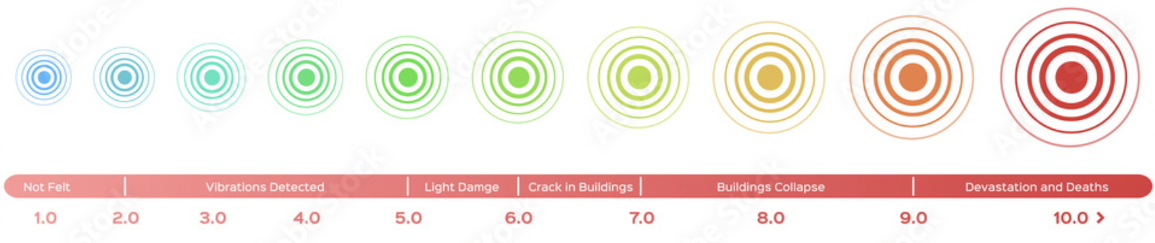
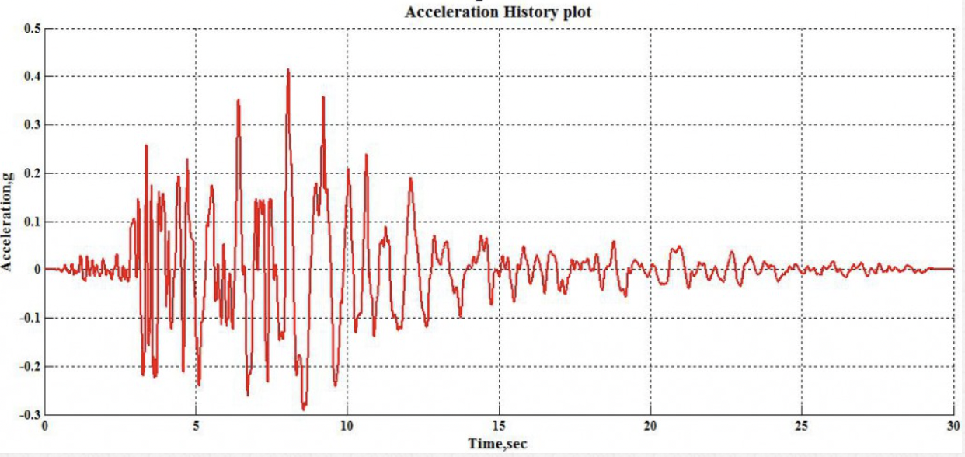
Research keywords
Risk Severity
Risk Frequency
Severity is measured in magnitude.
Magnitude is the size of the earthquake.
Frequency is how often a given earthquake with a certain magnitude comes about.

Slide 6
Problem Definition
To what degree can probability models be used to simulate and describe the occurrence of earthquakes?
Research Objectives
Frequency: use probability models to capture the number of occurrence of earthquakes above certain magnitude threshold within a fixed period of time.
Magnitude: use probability models to capture the distribution of earthquake magnitudes for all periods collected
Discuss the applicability and limitations of the models evaluated when simulating and describing the earthquake
Case Study
Earthquakes (M>3) in Sichuan Province from 2012 to 2023.

Slide 7
2. Literature Review

Slide 8
Literature review
Forecast Approach
Seismicity Clustering Analysis “Clustering analysis of seismicity in the space–time–depth–magnitude domain preceding the 2016 Kumamoto earthquake, Southwestern Japan” By Ansari and Bae | Identifies clusters or groups of earthquakes that occur in space and time. | Determine if earthquakes are occurring more frequently or in higher magnitudes within specific regions or along fault lines
Probability Models “A review of earthquake occurrence models for seismic hazard analysis” By Anagnos and Kiremidjian | Analyze data regarding earthquake recurrence intervals, magnitude-frequency distributions, and spatial clustering patterns | Generate the likelihood of future earthquakes Poisson Models, Markov Models, Semi-Markov Model, M–A approach
Precursor Analysis “Evaluation of Proposed Earthquake Precursors” by Wyss | Identifies and monitoring potential precursory signals or changes in geophysical parameters that precede earthquakes | Analyze and interpret these precursor signals or earthquake prediction

Slide 9
3. Methodology

Slide 10
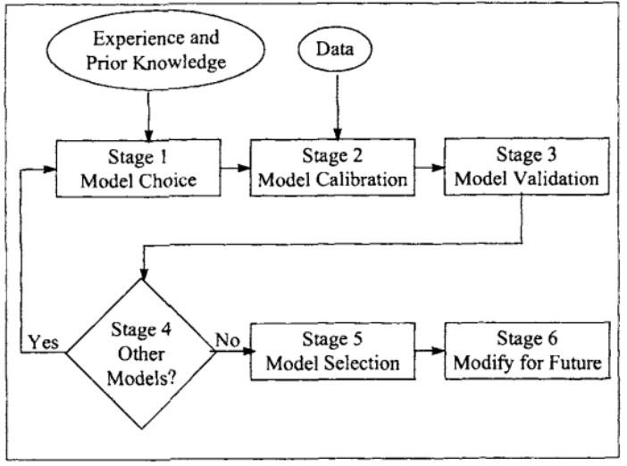
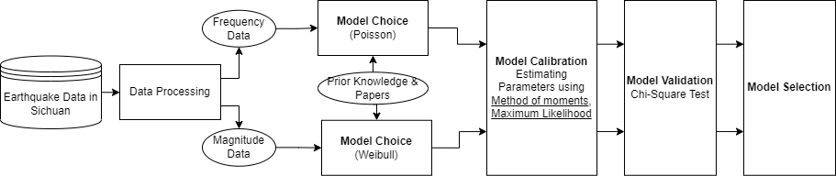
Basic Workflow

Slide 11
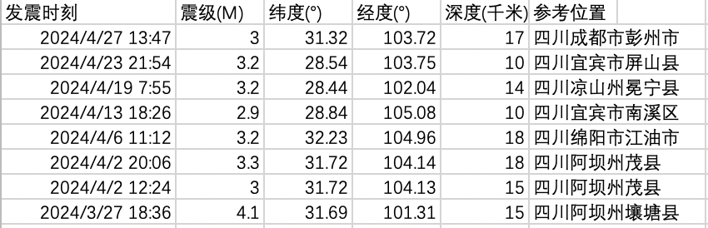
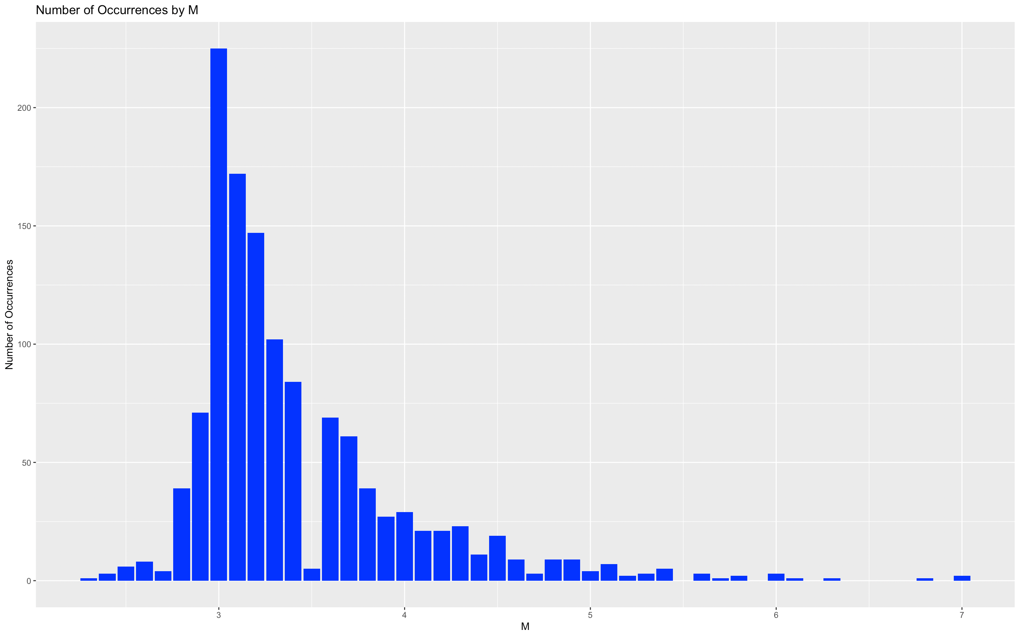
Stage 0. Raw Data
Data Description:
Study Year: 2012-2023
Study Region: Sichuan Province
Total Input: 1,252
Data Source:
China Earthquake Network Center
https://www.ceic.ac.cn/history
Limits of Data:
”The frequency for larger earthquakes therefore increases by a factor of about 10 when the magnitude is diminished by one unit.”
“Changes in frequency–size relationship from small to large earthquakes” by Pacheco et al
The part of sample data with M<3 disagrees with the above law, thus being removed in this study.
Notes:
However, upon literature research, it is noted that the frequency of earthquakes should increase as the magnitude decreases

Slide 12
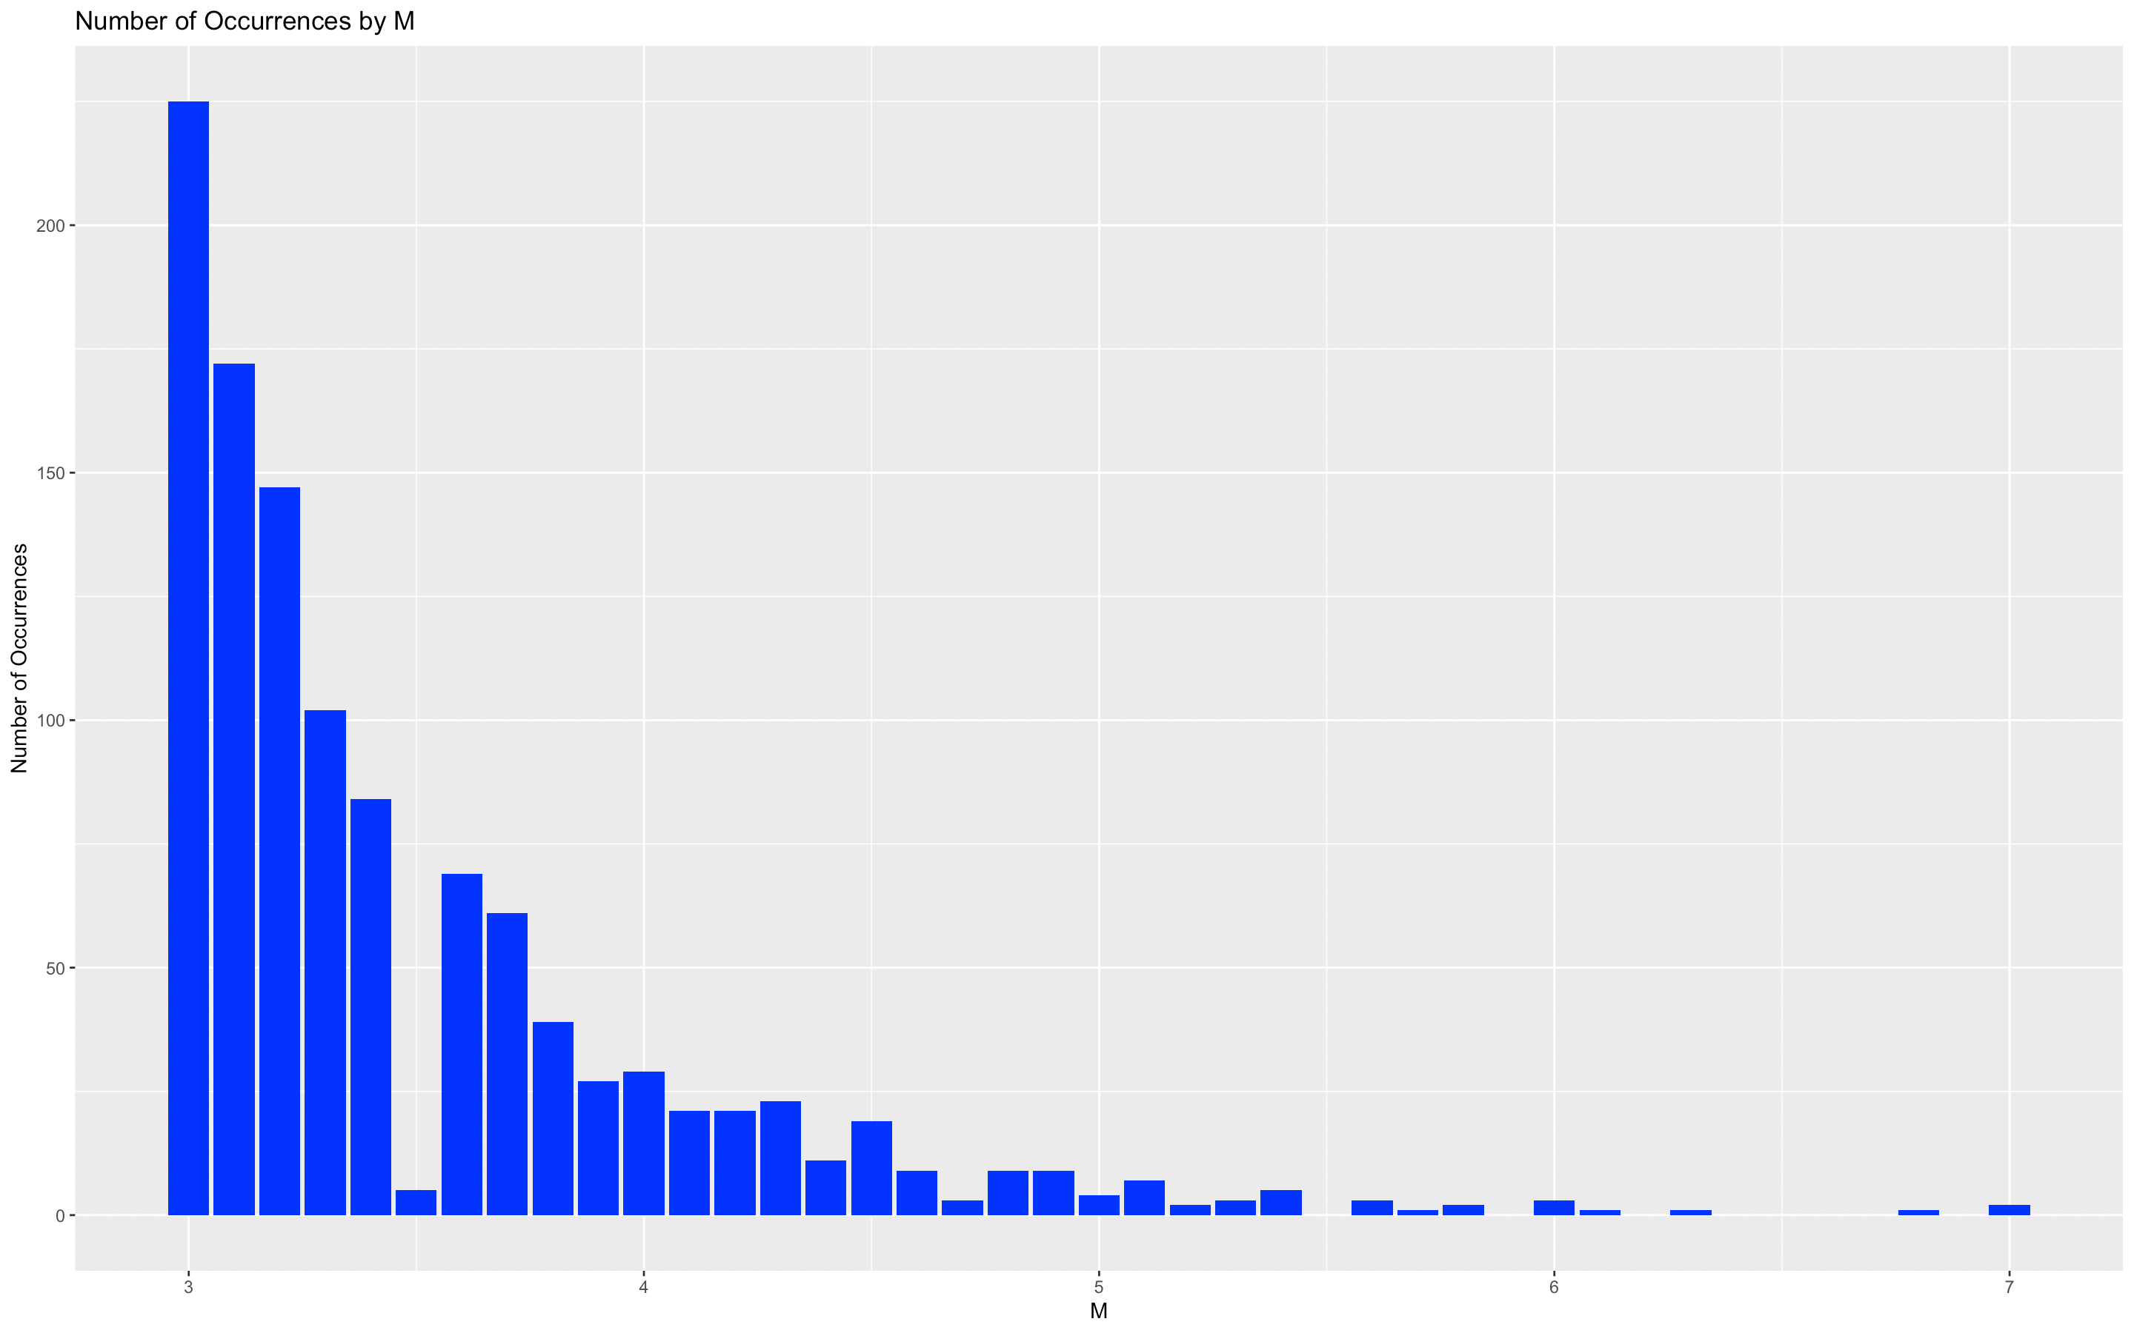
Stage 0. sample Data
Data Description:
Study Year: 2012-2023
Study Region: Sichuan Province
Data Input: 1120
Magnitude Range: 3-7M

Slide 13
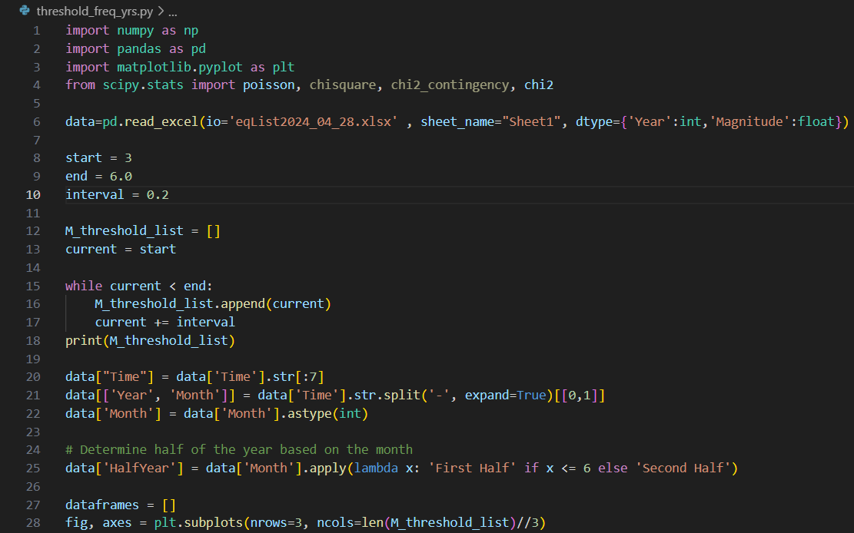
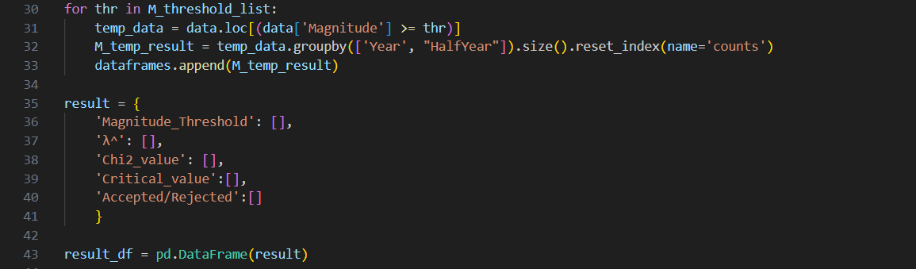
Data Processing Code
Read Data
Initialization
Data Formatting

Slide 14
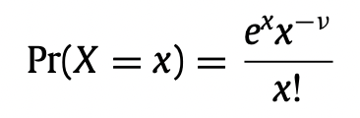
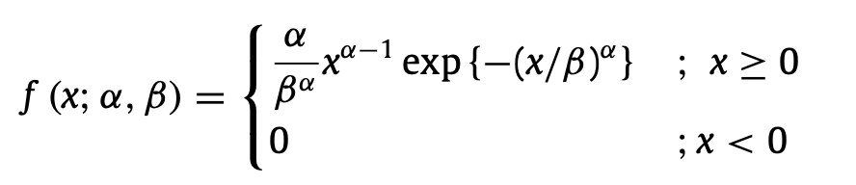
Stage 1. Model Choice
Frequency Model
Magnitude Model
The likelihood of an occurrence of the earthquake with a magnitude above certain threshold within a period of time
The likelihood of the earthquake has a certain magnitude given the occurrence
Poisson Distribution
Suitable for simulating the temporal occurrence of rare events
Weibull Distribution
can be highly skewed or symmetrical depending on parameters
Notes:
For instance, what is the frequency of an earthquake with a magnitude greater 6 occurs wthin half a year
For instance, what are the chances for an 8th magnitude given the occurrence of an earthquake
Poissob: unclear definition of rare events
Probability of magnitude
Magnitude Model: also consider M-A method, WeilBull seems to be a more widely recgnized and applied one.

Slide 15
Stage 2. Model Calibration
Poisson Distribution
Year | HalfYear | Counts (M>3.0)
2012 | First | 29
2012 | Second | 34
2013 | First | 184
2013 | Second | 45
2014 | First | 41
2014 | Second | 52
2015 | First | 29
2015 | Second | 30
2016 | First | 30
2016 | Second | 24
2017 | First | 25
2017 | Second | 68
2018 | First | 27
2018 | Second | 25
2019 | First | 89
2019 | Second | 56
2020 | First | 47
2020 | Second | 46
2021 | First | 31
2021 | Second | 47
2022 | First | 40
2022 | Second | 44
2023 | First | 48
2023 | Second | 29
Year | HalfYear | Counts (M>3.2)
2012 | First | 18
2012 | Second | 25
2013 | First | 123
2013 | Second | 30
2014 | First | 24
2014 | Second | 27
2015 | First | 19
2015 | Second | 19
2016 | First | 18
2016 | Second | 18
2017 | First | 18
2017 | Second | 43
2018 | First | 20
2018 | Second | 19
2019 | First | 54
2019 | Second | 37
2020 | First | 32
2020 | Second | 26
2021 | First | 16
2021 | Second | 27
2022 | First | 28
2022 | Second | 28
2023 | First | 34
2023 | Second | 20
Data Formatting
Year,
HalfYear,
counts of earthquakes that has magnitude larger than a threshold
Threshold is set as:
Lower-bound = 3.0
Upper-bound = 5.8
Step = 0.2

Slide 16
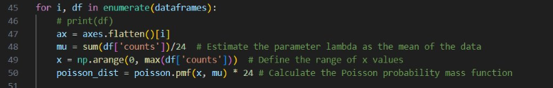
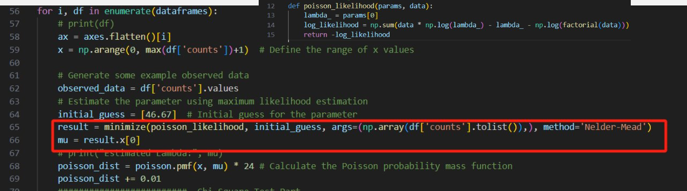
Stage 2. Model Calibration
Poisson Distribution
Parameter Estimation
λ^= mean of all Xi
Poisson λ estimation
Method of Moments
Poisson λ estimation
Maximum Likelihood Estimation

Slide 17
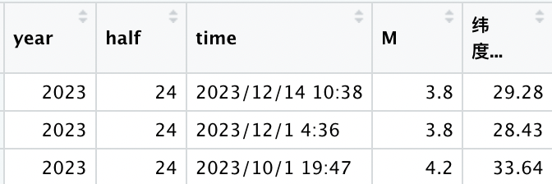
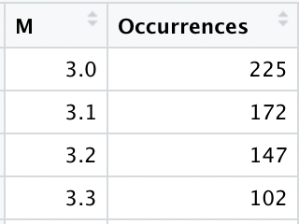
Stage 2. Model Calibration
Weibull Distribution
Data Formatting
Reorganize the data to find the number of occurences of each unique M and plot them against each other

Slide 18
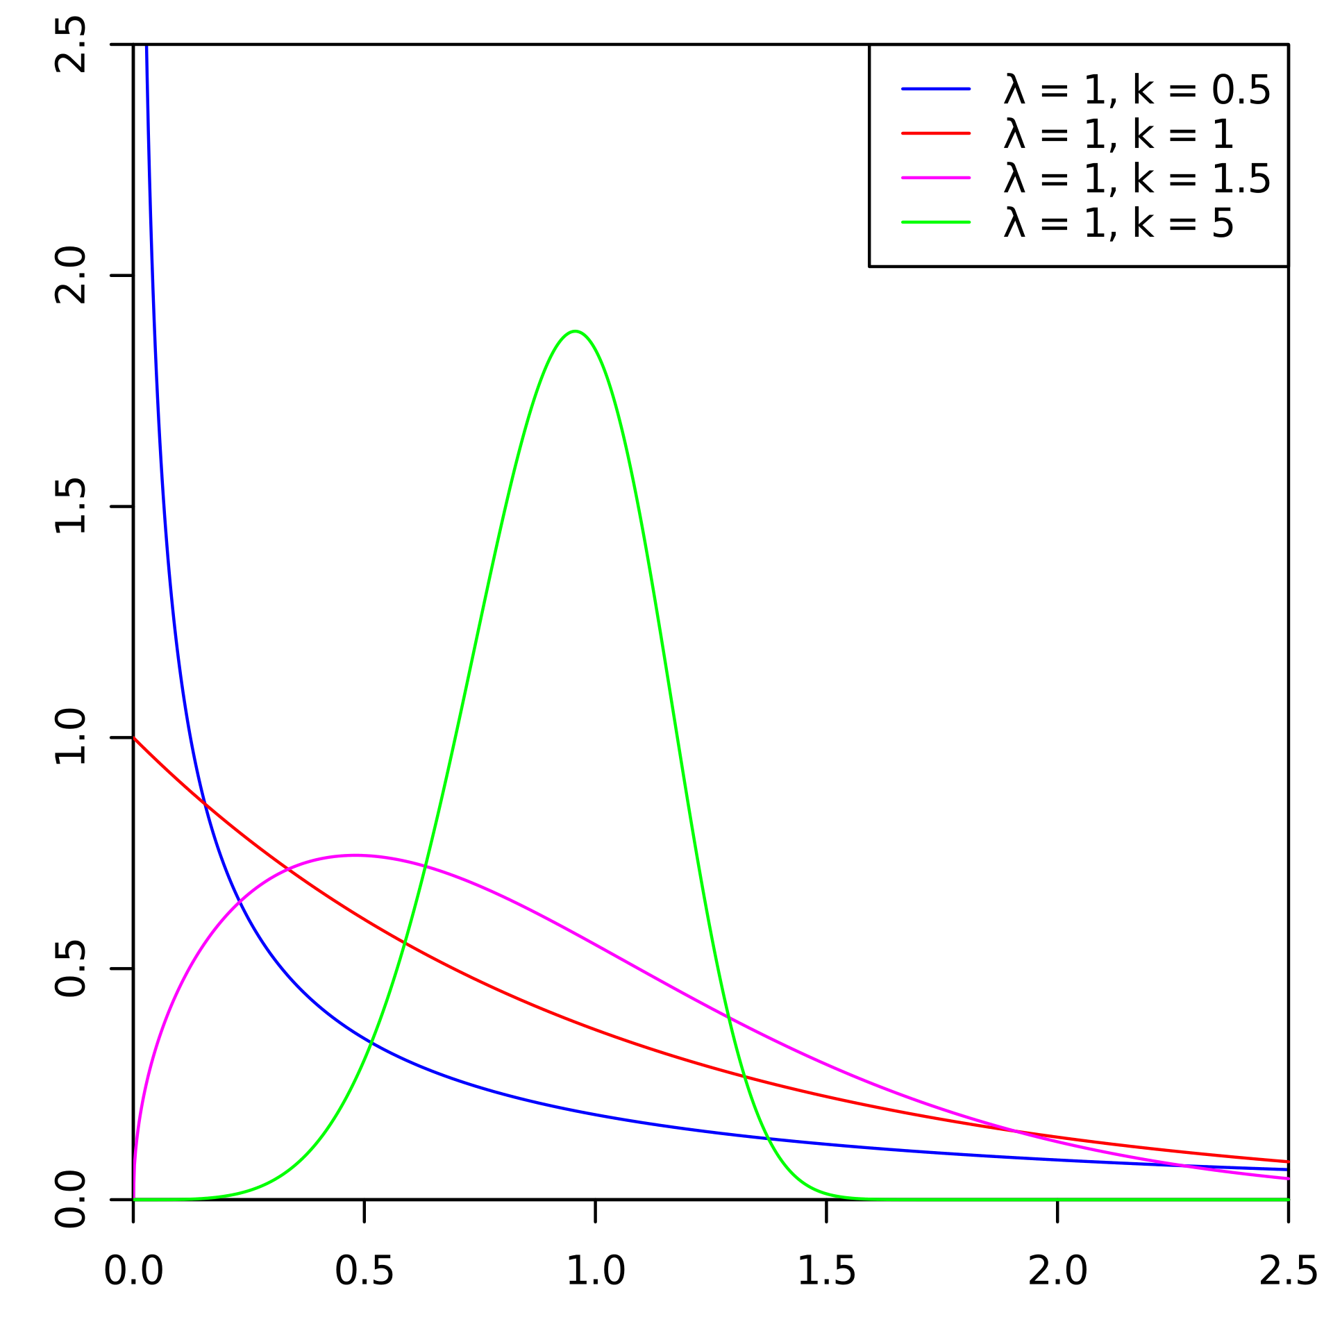
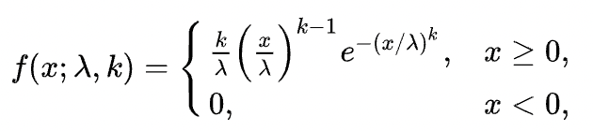
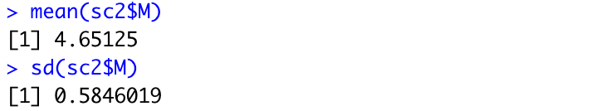
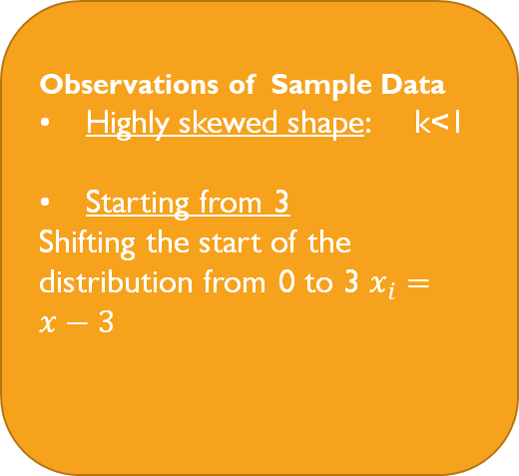

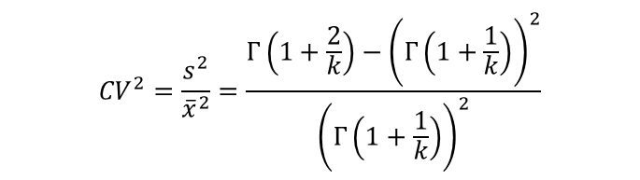
Stage 2. Model Calibration
Weibull Distribution
Parameter Estimation
Observations of Sample Data
Highly skewed shape: k<1
Starting from 3
Shifting the start of the distribution from 0 to 3 $x_{i}=x−3$
Method of Moments
$${CV}^{2}=\frac{s^{2}}{{\overline{x}}^{2}}=\frac{Γ\left(1+\frac{2}{k}\right)−{\left(Γ\left(1+\frac{1}{k}\right)\right)}^{2}}{{\left(Γ\left(1+\frac{1}{k}\right)\right)}^{2}}$$
$$\hat{λ}=\frac{\overline{x}}{Γ\left(1+\frac{1}{\overline{k}}\right)}$$

Slide 19
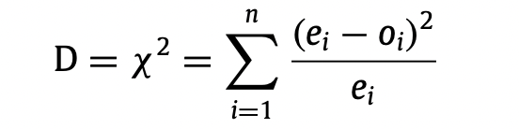
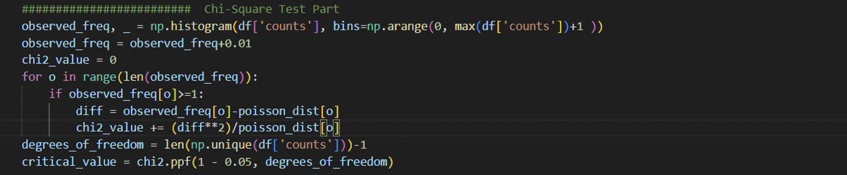
Stage 3. model validation
Chi-Square Test
Level of Significance: 5%
To examine whether the target models should be statistically accepted

Slide 20
4. Experimental Result Analysis

Slide 21
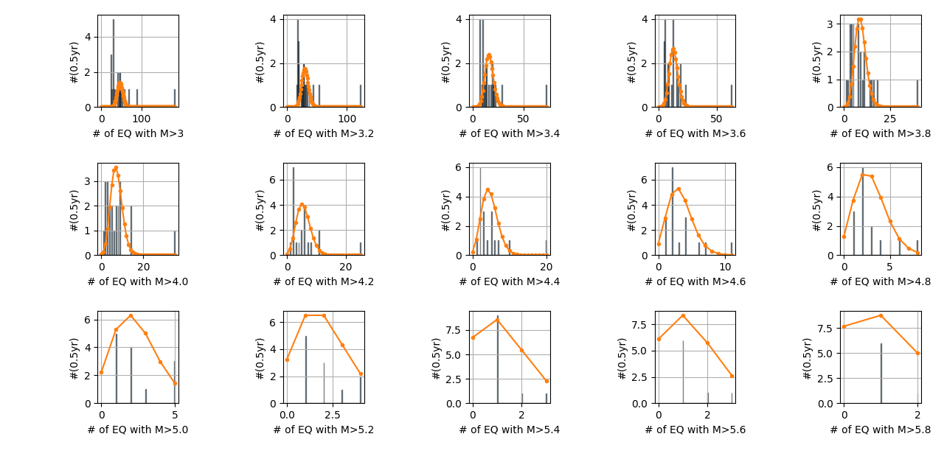
Poisson-Calibration result
Number of earthquake above a threshold —— Poisson Distribution, estimated using Method of Moments
Black line: The sample data of Earthquake Occurences
Not Fitting Well when:
Some years with large number of earthquake (outlier) exists.
Magnitude threshold is too large (Too few samples)

Slide 22

Poisson-Calibration result
Number of earthquake above a threshold —— Poisson Distribution, estimated using Maximum Likelihood Estimator
Same Estimated λ^ as MOM

Slide 23
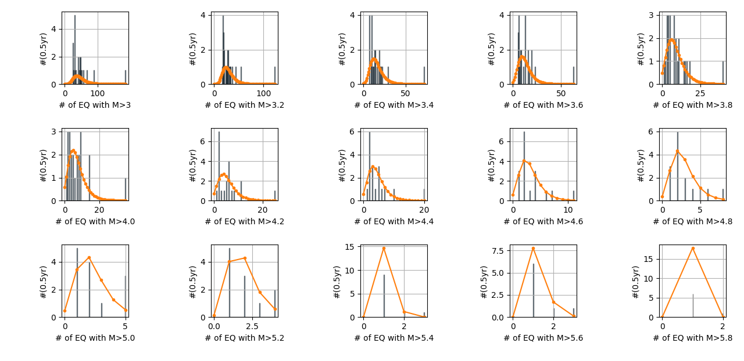
Poisson-Calibration result
Number of earthquake above a threshold —— Gumbel Distribution, estimated using Maximum Likelihood Estimator
For High-Severity , Low-Frequency Events.

Slide 24
Poisson-calibration result
Number of earthquake above a threshold —— Poisson Distribution, estimated using Method of Moments
Chi-Square Test
Level of significance: α = 0. 05
Magnitude_Threshold | λ^ | Chi2_value | Critical_value | Accepted/Rejected
3 | 46.67 | 888.65 | 28.87 | Rejected
3.2 | 30.13 | 370.47 | 25.00 | Rejected
3.4 | 16.25 | 250.66 | 23.68 | Rejected
3.6 | 13.17 | 202.26 | 19.68 | Rejected
3.8 | 9.00 | 173.36 | 22.36 | Rejected
4 | 7.27 | 140.72 | 18.31 | Rejected
4.2 | 5.62 | 135.88 | 16.92 | Rejected
4.4 | 4.67 | 111.87 | 15.51 | Rejected
4.6 | 3.29 | 24.96 | 12.59 | Rejected
4.8 | 2.93 | 5.83 | 12.59 | Accepted
5 | 2.38 | 4.03 | 7.81 | Accepted
5.2 | 2.00 | 2.63 | 7.81 | Accepted
5.4 | 1.27 | 2.20 | 5.99 | Accepted
5.6 | 1.38 | 3.09 | 5.99 | Accepted
5.8 | 1.14 | 0.35 | 3.84 | Accepted

Slide 25
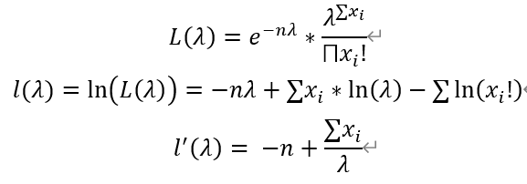
Poisson-calibration result
Number of earthquake above a threshold —— Poisson Distribution, estimated using Maximum Likelihood Estimation
Chi-Square Test
Level of significance: α = 0. 05
Magnitude_Threshold | λ^ | Chi2_value | Critical_value | Accepted/Rejected
3 | 46.67 | 888.65 | 28.87 | Rejected
3.2 | 30.13 | 370.47 | 25.00 | Rejected
3.4 | 16.25 | 250.66 | 23.68 | Rejected
3.6 | 13.17 | 202.26 | 19.68 | Rejected
3.8 | 9.00 | 173.36 | 22.36 | Rejected
4 | 7.27 | 140.72 | 18.31 | Rejected
4.2 | 5.62 | 135.88 | 16.92 | Rejected
4.4 | 4.67 | 111.87 | 15.51 | Rejected
4.6 | 3.29 | 24.96 | 12.59 | Rejected
4.8 | 2.93 | 5.83 | 12.59 | Accepted
5 | 2.38 | 4.03 | 7.81 | Accepted
5.2 | 2.00 | 2.63 | 7.81 | Accepted
5.4 | 1.27 | 2.20 | 5.99 | Accepted
5.6 | 1.38 | 3.09 | 5.99 | Accepted
5.8 | 1.14 | 0.35 | 3.84 | Accepted
Same Estimated λ^ ! As MOM

Slide 26
Poisson-Calibration result
Number of earthquake above a threshold —— Gumbel Distribution, estimated using Maximum Likelihood Estimation
Chi-Square Test
Level of significance: α = 0. 05
Magnitude_Threshold | location^ | scale^ | Chi2_value | Critical_value | Accepted/Rejected
3 | 36.05 | 14.77 | 153.13 | 28.87 | Rejected
3.2 | 23.43 | 9.09 | 133.72 | 25.00 | Rejected
3.4 | 12.02 | 6.04 | 118.00 | 23.68 | Rejected
3.6 | 9.30 | 5.54 | 117.21 | 19.68 | Rejected
3.8 | 5.98 | 4.58 | 78.05 | 22.36 | Rejected
4 | 4.76 | 3.70 | 91.42 | 18.31 | Rejected
4.2 | 3.68 | 2.87 | 80.15 | 16.92 | Rejected
4.4 | 3.10 | 2.22 | 68.25 | 15.51 | Rejected
4.6 | 2.27 | 1.52 | 15.94 | 12.59 | Rejected
4.8 | 2.10 | 1.28 | 4.61 | 12.59 | Accepted
5 | 1.69 | 1.07 | 4.20 | 7.81 | Accepted
5.2 | 1.49 | 0.80 | 1.43 | 7.81 | Accepted
5.4 | 1.05 | 0.27 | 2.75 | 5.99 | Accepted
5.6 | 1.10 | 0.36 | 0.46 | 5.99 | Accepted
5.8 | 1.02 | 0.14 | 6.57 | 3.84 | Rejected

Slide 27

WEibull –calibration result
Sample Data Description:
Magnitude>3
Mean= 3.487589
Sd= 0.5875971
Weibull Distribution Estimation
Shape <- 0.95
Scale <- 0.5
Chi-Square Test
(Level of Significance=0.05)
Df=33
Chi-Square Value=133.8326
Critical Value=47.4
REJECT

Slide 28
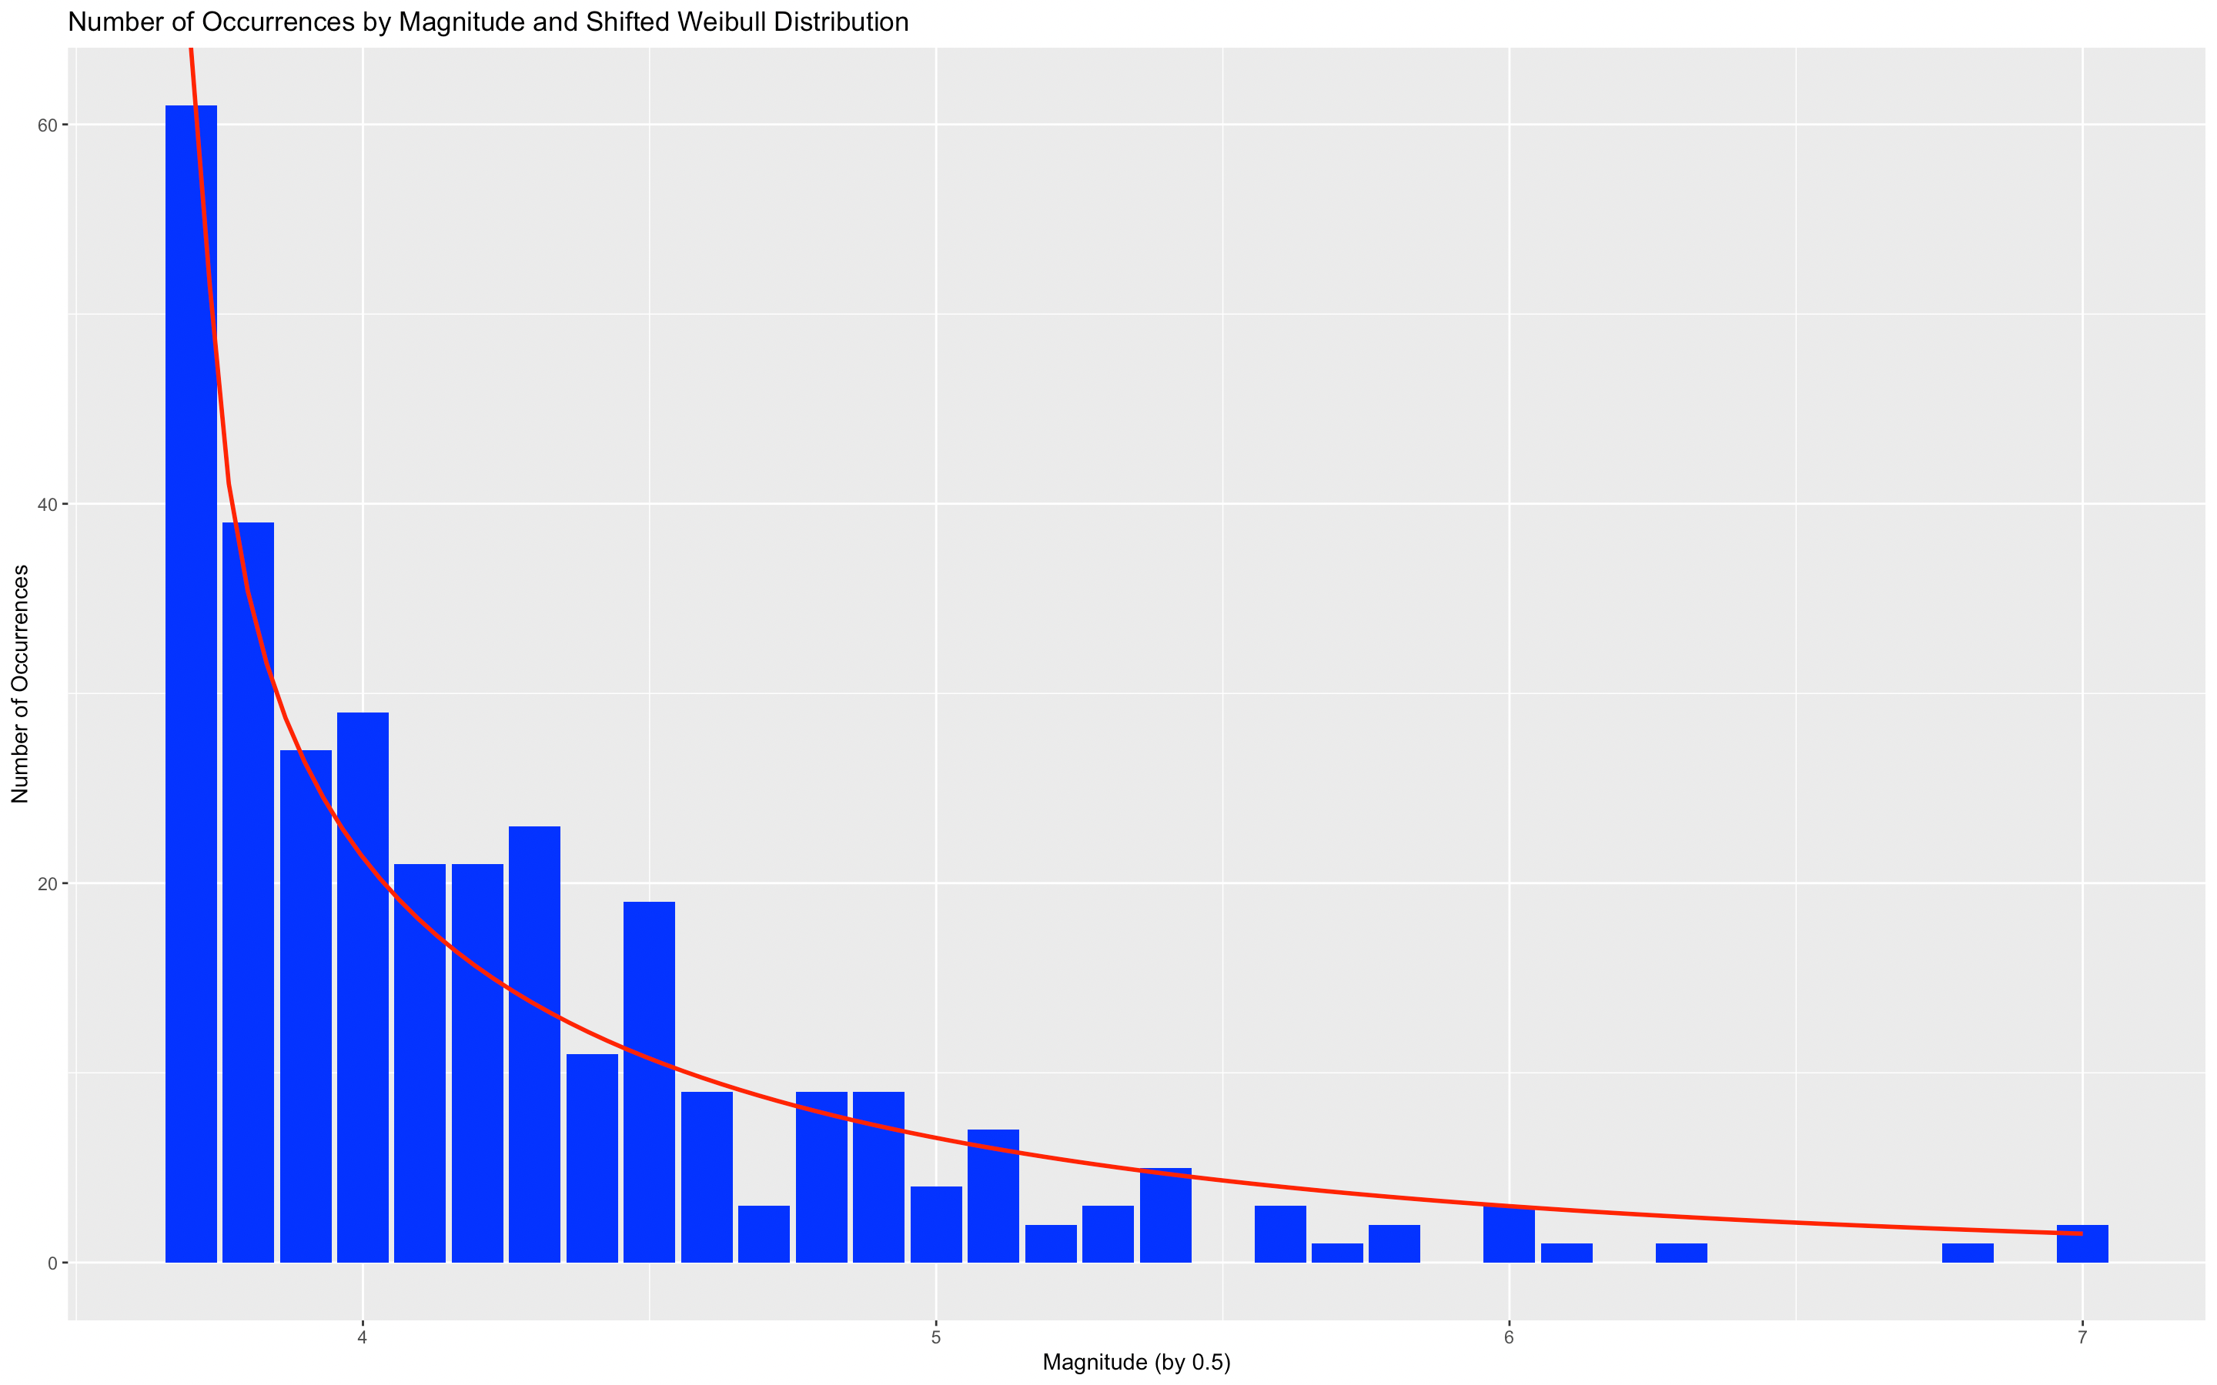
WEibull –calibration result
Sample Data Description:
Magnitude>3.6
Mean= 4.238608
Sd= 0.5950296
Weibull Distribution Estimation
Shape <- 0.75
Scale <- 1
Chi-Square Test
(Level of Significance=0.05)
Df=21
Chi-Square Value=32.6
Critical Value=37.65
ACCEPT

Slide 29
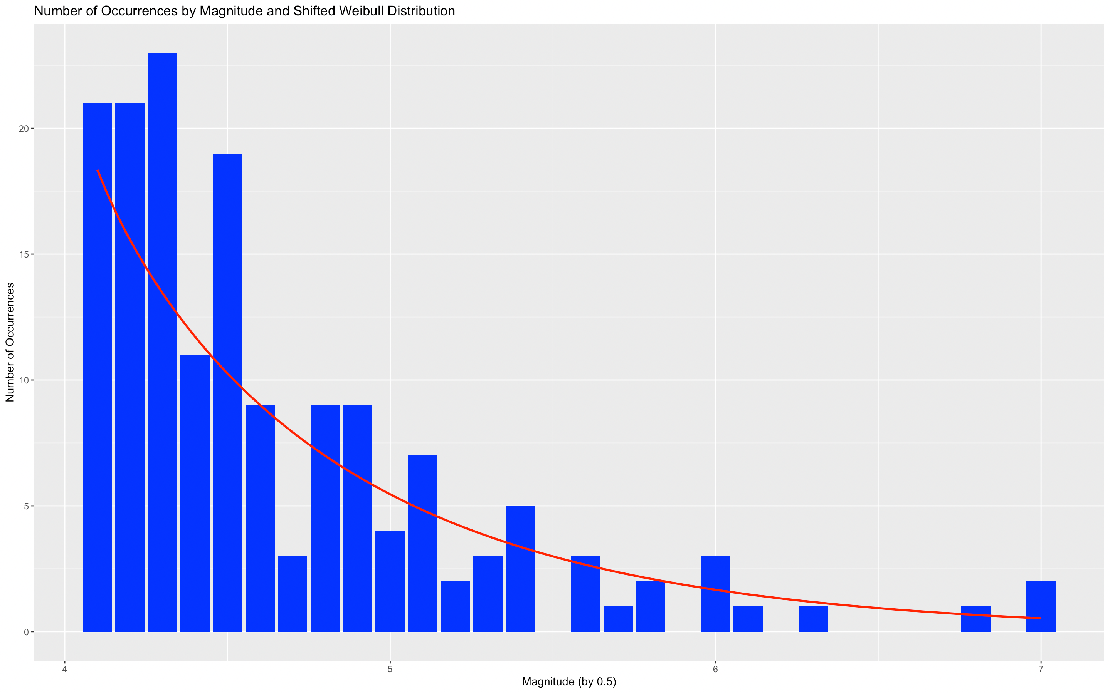
WEibull –calibration result
Sample Data Description:
Magnitude>4
Mean= 4.65125
Sd= 0.5846019
Weibull Distribution Estimation
Shape <- 0.95
Scale <- 0.8
Chi-Square Test
(Level of Significance=0.05)
Df=16
Chi-Square Value=31.3088
Critical Value=33.92444
ACCEPT

Slide 30
5. Conclusion & discussion

Slide 31
Conclusions
For Frequency Models modelling Sichuan Earthquakes:
Models based on Poisson Distribution are accepted when Magnitude threshold is greater than 4.8.
The standard for an earthquake to be considered as a rare event should be around of 2.93, below which the earthquake’s temporal occurrence could be modeled by the Poisson distribution.
This is somehow in agreement with textbooks that suggest the Poisson distribution should be able to capture the temporal occurrence of rare events
For Magnitude Models modelling Sichuan Earthquakes:
Models based on Weibull Distribution are accepted with strong statistical significance when magnitude threshold is greater than 3.6
While the peer literatures suggest Weibull Distribution should be able to well capture the overall observed data, the anomaly at M=3.5 should be the major reason causing the different conclusion reached.

Slide 32
Study evaluation
Reflection 1
Reflection 2
Bigger dataset to be collected from a longer time horizon, preferably longer than 30 years
Data limits to be explored, by understanding the reasons causing anomalies

Slide 33
6. References

Slide 34
1. Rahman, Md.H. and Hossain, Md.M. (2019) ‘Distribution of earthquake magnitude levels in Bangladesh’, Journal of Geography and Geology, 11(3), p. 15.
Wu, M.-H., Wang, J. P., & Ku, K.-W. (2019). Earthquake, Poisson and Weibull distributions. Physica A: Statistical Mechanics and Its Applications, 526, 121001. https://doi.org/10.1016/j.physa.2019.04.237
Chen, Q., & Wang, K. (2010). The 2008 Wenchuan Earthquake and Earthquake Prediction in China. Bulletin of The Seismological Society of America - BULL SEISMOL SOC AMER, 100, 2840–2857. https://doi.org/10.1785/0120090314

Slide 35
Thank you!

